Slide 1
Storytime GPT
Llewellyn Falco
Notes:
https://chatgpt.com/c/724739f2-321d-455b-b882-84645a21c626

Slide 2
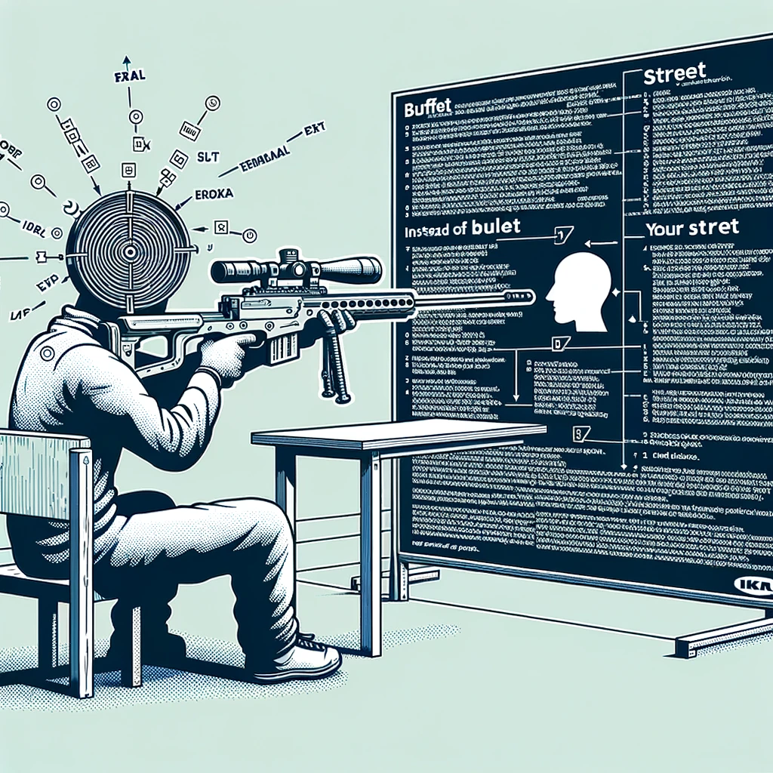
Concept Zero Shot Prompting

Slide 3

Concept The Wall
?
?
?
?

Slide 4
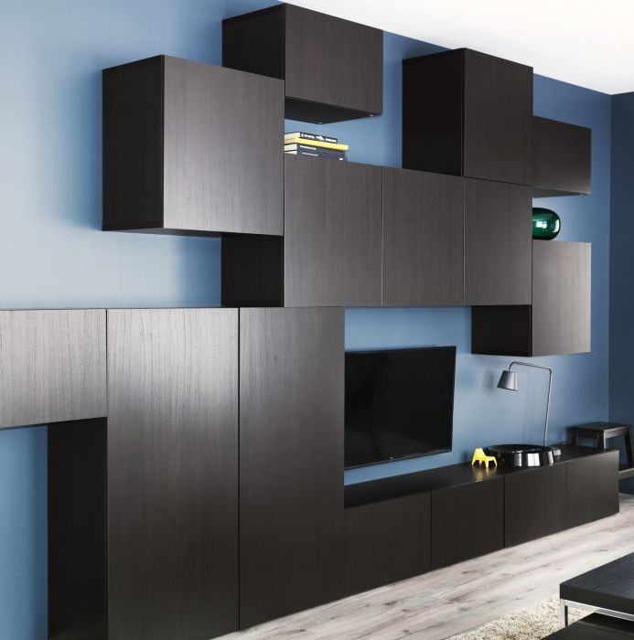
Hackea (Hack + Ikea) &Other ways of getting what you want

Slide 5
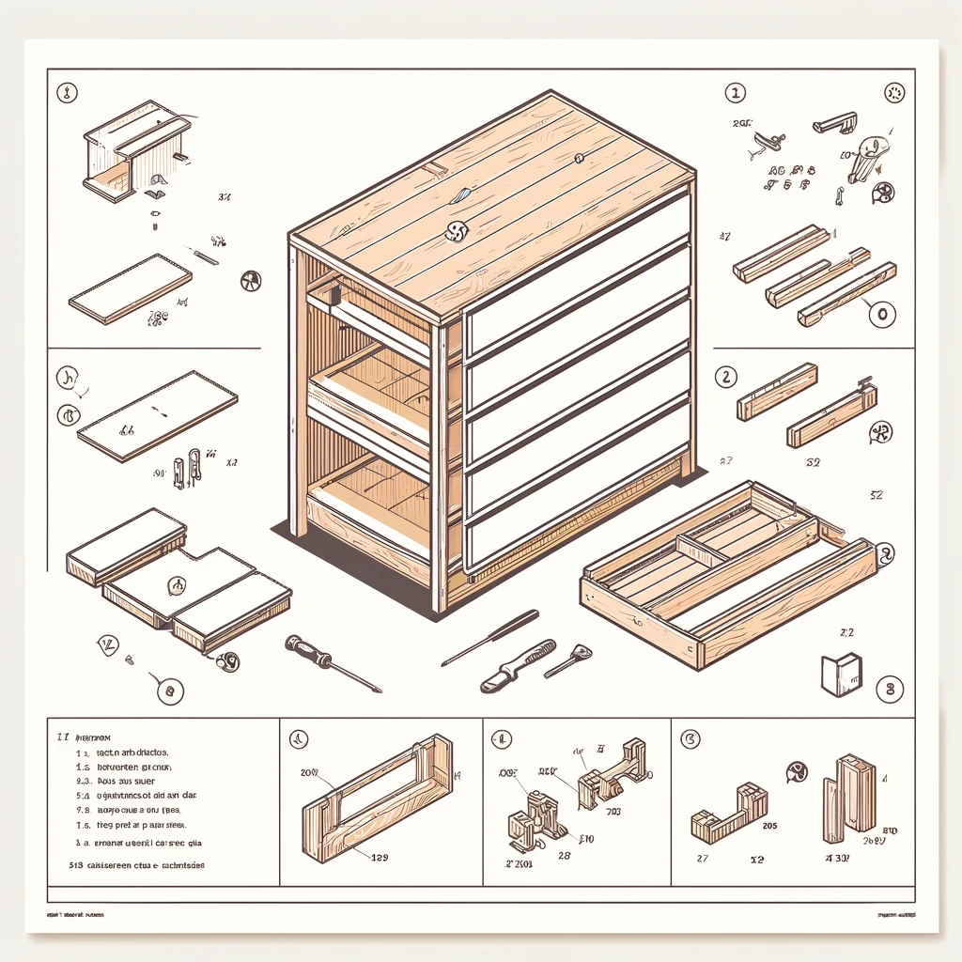
Parts Some assembly required

Slide 6
Story
Create interview prompt (group)
Story (pairs)
Share
Slides
Prompt (group)
Create Slides
Images
Storytime

Slide 7

Concept Multi-step Prompt Here’s the plan, Here’s the details

Slide 8

Concept Markdown
# Header 1
## Header 2
Inline `code` example **Bold:** text
*Italic:* text

Slide 9
Markdown formatting
Headers
Use # for headers
# Header 1
## Header 2
### Header 3
Emphasis
Bold: bold text
Italic: italic text
UPPERCASE
Code
Inline `code` example
```java
Multiline
Codeblock
```
Lists
Item 1
Item 2
Item 2.1
Item 2.2
Links
Inline link:
[description](url) [OpenAI](https://www.openai.com) => OpenAI

Slide 10
Concept Choices

Slide 11
ChatGPT
Markdown
ChatGPT
LLM
ChatGPT
Text
Markdown
(Zero shot) Question
Mermaid
Output Formatting
Code
CLI
Only show code
DALL·E 3
SVG
Images
LaTeX
Iterative
Python
Process
Interview
File Output
Results
Planning
Zip
Bing / Browser
Powerpoint
Review
Your File Format
ChatGPT

Slide 12
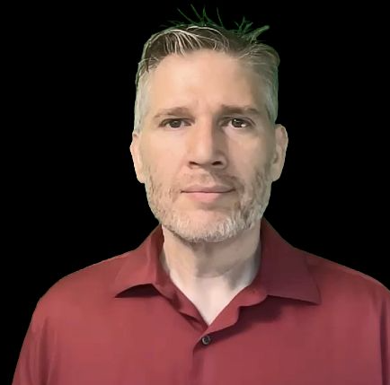
Resources
Thank you!
Llewellyn Falco
Please connect on LinkedIn
https://github.com/isidore/Talks/blob/master/TddWithChatGpt
Notes:
https://github.com/isidore/Talks/blob/master/ChatGPTPrompting.md

